Slide 1

Economic Trends & Strategic Investing
Crypto, AI, Housing & Policy Insights (2019–2030)
July 28, 2025

Slide 2
Agenda
Market Trends: S&P 500, Bitcoin, Ethereum & XLP
Government & Policy Landscape
Ripple & Major Holders
AI, Real Estate & Macro Outlook
Portfolio Simulations
Recommendations & Patterns

Slide 3
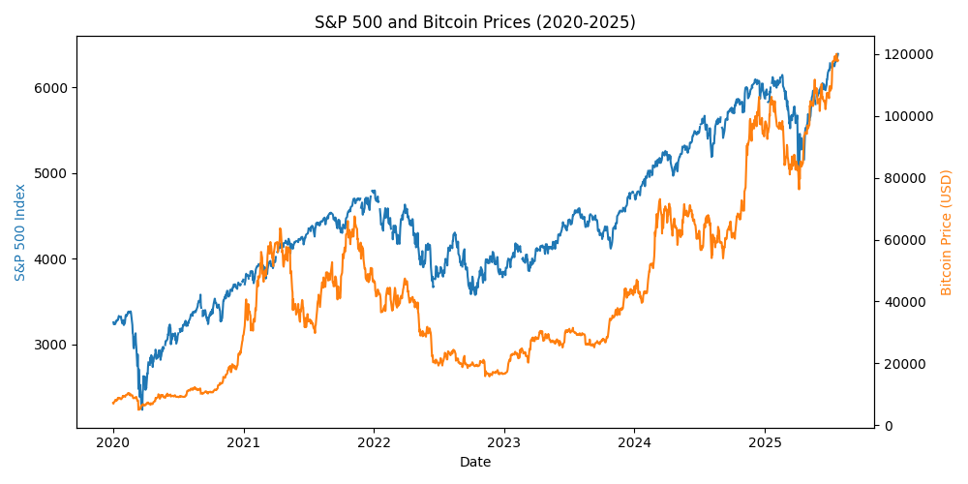
Market Trends (2019–2025)
S&P 500 plunged ~34% in Mar 2020, recovering by Aug 2020 and reaching new highs amid stimulus and AI optimism.
Bitcoin surged 416% in 2020, peaked at $69k in Nov 2021, crashed below $20k in 2022, then rebounded above $100k by May 2025.
Ether climbed from $186 to over $4.8k during 2020–21, fell in 2022 and traded near $3.8k by Jul 2025.
Consumer staples (XLP) dropped less than cyclicals during the crash and provided defensive stability.
[1] [2] [3] [4]

Slide 4
Government & Policy Actions (2025)
Strategic Bitcoin Reserve: orders seized BTC to be retained and used as a national reserve asset.
Crypto Week bills: GENIUS Act (100%‑backed stablecoins) and CLARITY Act provide regulatory clarity; Anti‑CBDC Act blocks a U.S. digital currency.
OBBBA housing & AI: expands housing tax credits and requires domestic AI supply chains, restricting foreign entities.
Reciprocal tariffs raise import duties (25–36%) and may increase inflationary pressures.
AI Action Plan: 90+ policy actions to accelerate AI innovation, build infrastructure and lead globally.
Inflation remains above 3% through 2025; Fed expected to cut rates gradually toward 3.25% by 2026.
[5] [6] [7] [8] [9] [10] [11]

Slide 5
Ripple & Major Crypto Holders
Ripple holds about 4.56 billion XRP and locks ~37 billion in escrow, ~40% of supply.
XRP acts as a bridge currency for cross‑border payments, enabling instant settlement without prefunding.
U.S. government holds >207k BTC via seized assets; Strategic Reserve aims to accumulate more.
MicroStrategy & Michael Saylor own hundreds of thousands of BTC, spearheading corporate adoption.
Tesla retains ~9,720 BTC; Elon Musk remains a vocal crypto supporter.
[12] [13] [14] [15] [16]

Slide 6
AI & Macro Outlook (2025–2030)
AI could add $15.7 trillion to global GDP by 2030 (PwC), with big gains in productivity and consumption.
Humanoid robot market may exceed $5 trillion by 2050; Tesla’s robotaxi & Optimus robots could create a $24 trillion opportunity.
U.S. residential real estate set to grow from $2.64 trillion (2025) to $3.11 trillion by 2030 (3.3% CAGR).
Long‑term equity returns expected in the high single digits; bonds mid‑single digits; cash low single digits.
Inflation likely to remain above 3% into 2026; Fed funds rate expected to converge toward ~3.25% by 2026.
[17] [18] [19] [20] [21] [22]

Slide 7
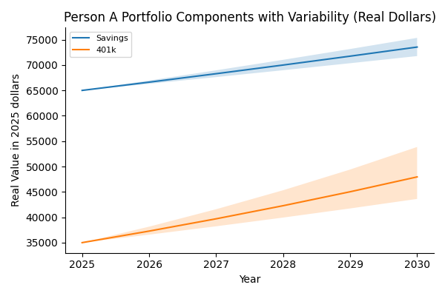
Portfolio Projection: Person A
Person A: savings & 401(k) with variability
[23] [24]

Slide 8
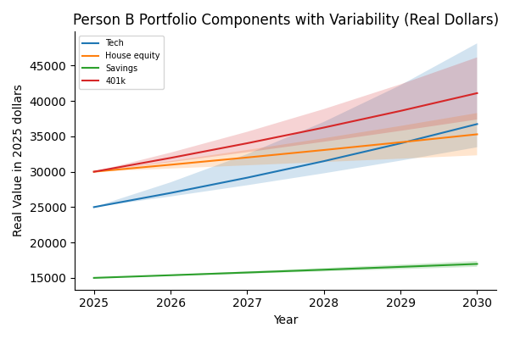
Portfolio Projection: Person B
Person B: tech, real estate, savings & 401(k) with variability
[25] [26]

Slide 9
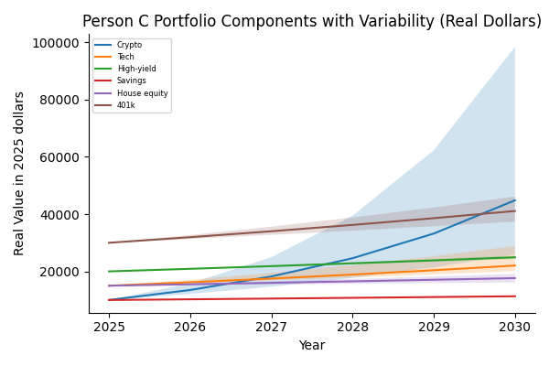
Portfolio Projection: Person C
Person C: crypto, tech, high‑yield, savings, house & 401(k) with variability
[27] [28]

Slide 10
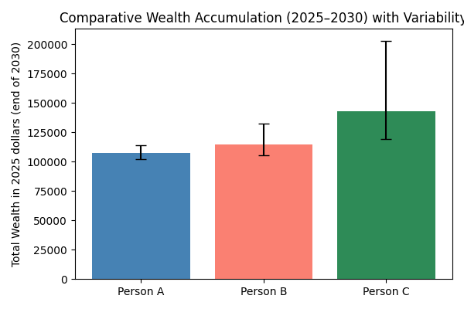
Comparative Wealth Outcomes
Total real wealth and variability by 2030 for Persons A–C
[29] [30]

Slide 11
Key Patterns & Strategic Recommendations
Moderate correlation: stock and crypto rallies both follow liquidity and risk sentiment; diversification reduces drawdowns.
Government adoption of BTC (strategic reserve, crypto legislation) legitimizes digital assets and could reduce supply.
AI revolution & protectionist policies will drive investment in semiconductors, cloud and robotics but also raise costs.
Inflation expected >3% into 2026; diversify into real assets and high‑yield savings to preserve purchasing power.
Suggested allocation: 30–40% diversified equities/401(k), 15–25% high‑yield cash, 10–20% real estate, 15–25% AI/tech, 5–10% crypto.
Consider term life insurance to protect dependents and lock in premiums; balance insurance costs against investment goals.
Reassess regularly as technology, policy and markets evolve; maintain liquidity and avoid overexposure to any single sector.
[31] [32] [33] [34]

